Slide 1

WELCOME TO COMPSCI 1 1 Principles of Programming
Lecture 1 - Introduction

Slide 2
Learning outcomes
At the end of this lecture, students should be able to:
understand where to obtain information about CompSci 101
understand which parts of the CompSci 101 assessment contribute to the invigilated practical mark
understand which parts of the CompSci 101 assessment contribute to the theory mark
understand that to pass CompSci 101, both the invigilated practical part of the course and the theory part of the course need to be passed
understand an algorithm

Slide 3
We are using Canvas
As well as using Canvas, CompSci 101 has a course website:
We will be using the Canvas Learning Management system this semester. All the material on the CompSci 101 website can also be accessed through Canvas:
https://www.cs.auckland.ac.nz/courses/compsci101ssc/
https://canvas.auckland.ac.nz
Notes:
Lecture management system

Slide 4
The CompSci 101 website
The CompSci 101 website can be reached by logging onto the Canvas website:
OR by going directly to the CompSci 101 website:
Here you will find all the information about our course set up.
Get used to looking at this website for information about lecture slides, lab documents, assignment resources, assessment, people involved in the course and lots more.
https://canvas.auckland.ac.nz
https://www.cs.auckland.ac.nz/courses/compsci101ssc/
Course Information Document
People
Lectures
Labs
Assignments
Tests, Exams
Notes:
Change pic

Slide 5
People in this course
Ann Cameron (Course Coordinator and
Lab Supervisor)
Email: ann@cs.auckland.ac.nz
Phone: 9234947
Room: 303.413

Slide 6
People in this course
Angela Chang (Lecturer)
Email: a.chang@auckland.ac.nz
Phone: 9236620
Room: 303.414

Slide 7
People in this course
Damir Azhar (Lecturer)
Email: damir.azhar@auckland.ac.nz
Phone: 9232391
Room: 303.411

Slide 8

People in this course
Adriana Ferraro (Lecturer)
Email: adriana@cs.auckland.ac.nz
Phone: 9237113
Room: 303.415

Slide 9


Office Hours
Open door policy – Visit any time

Slide 10
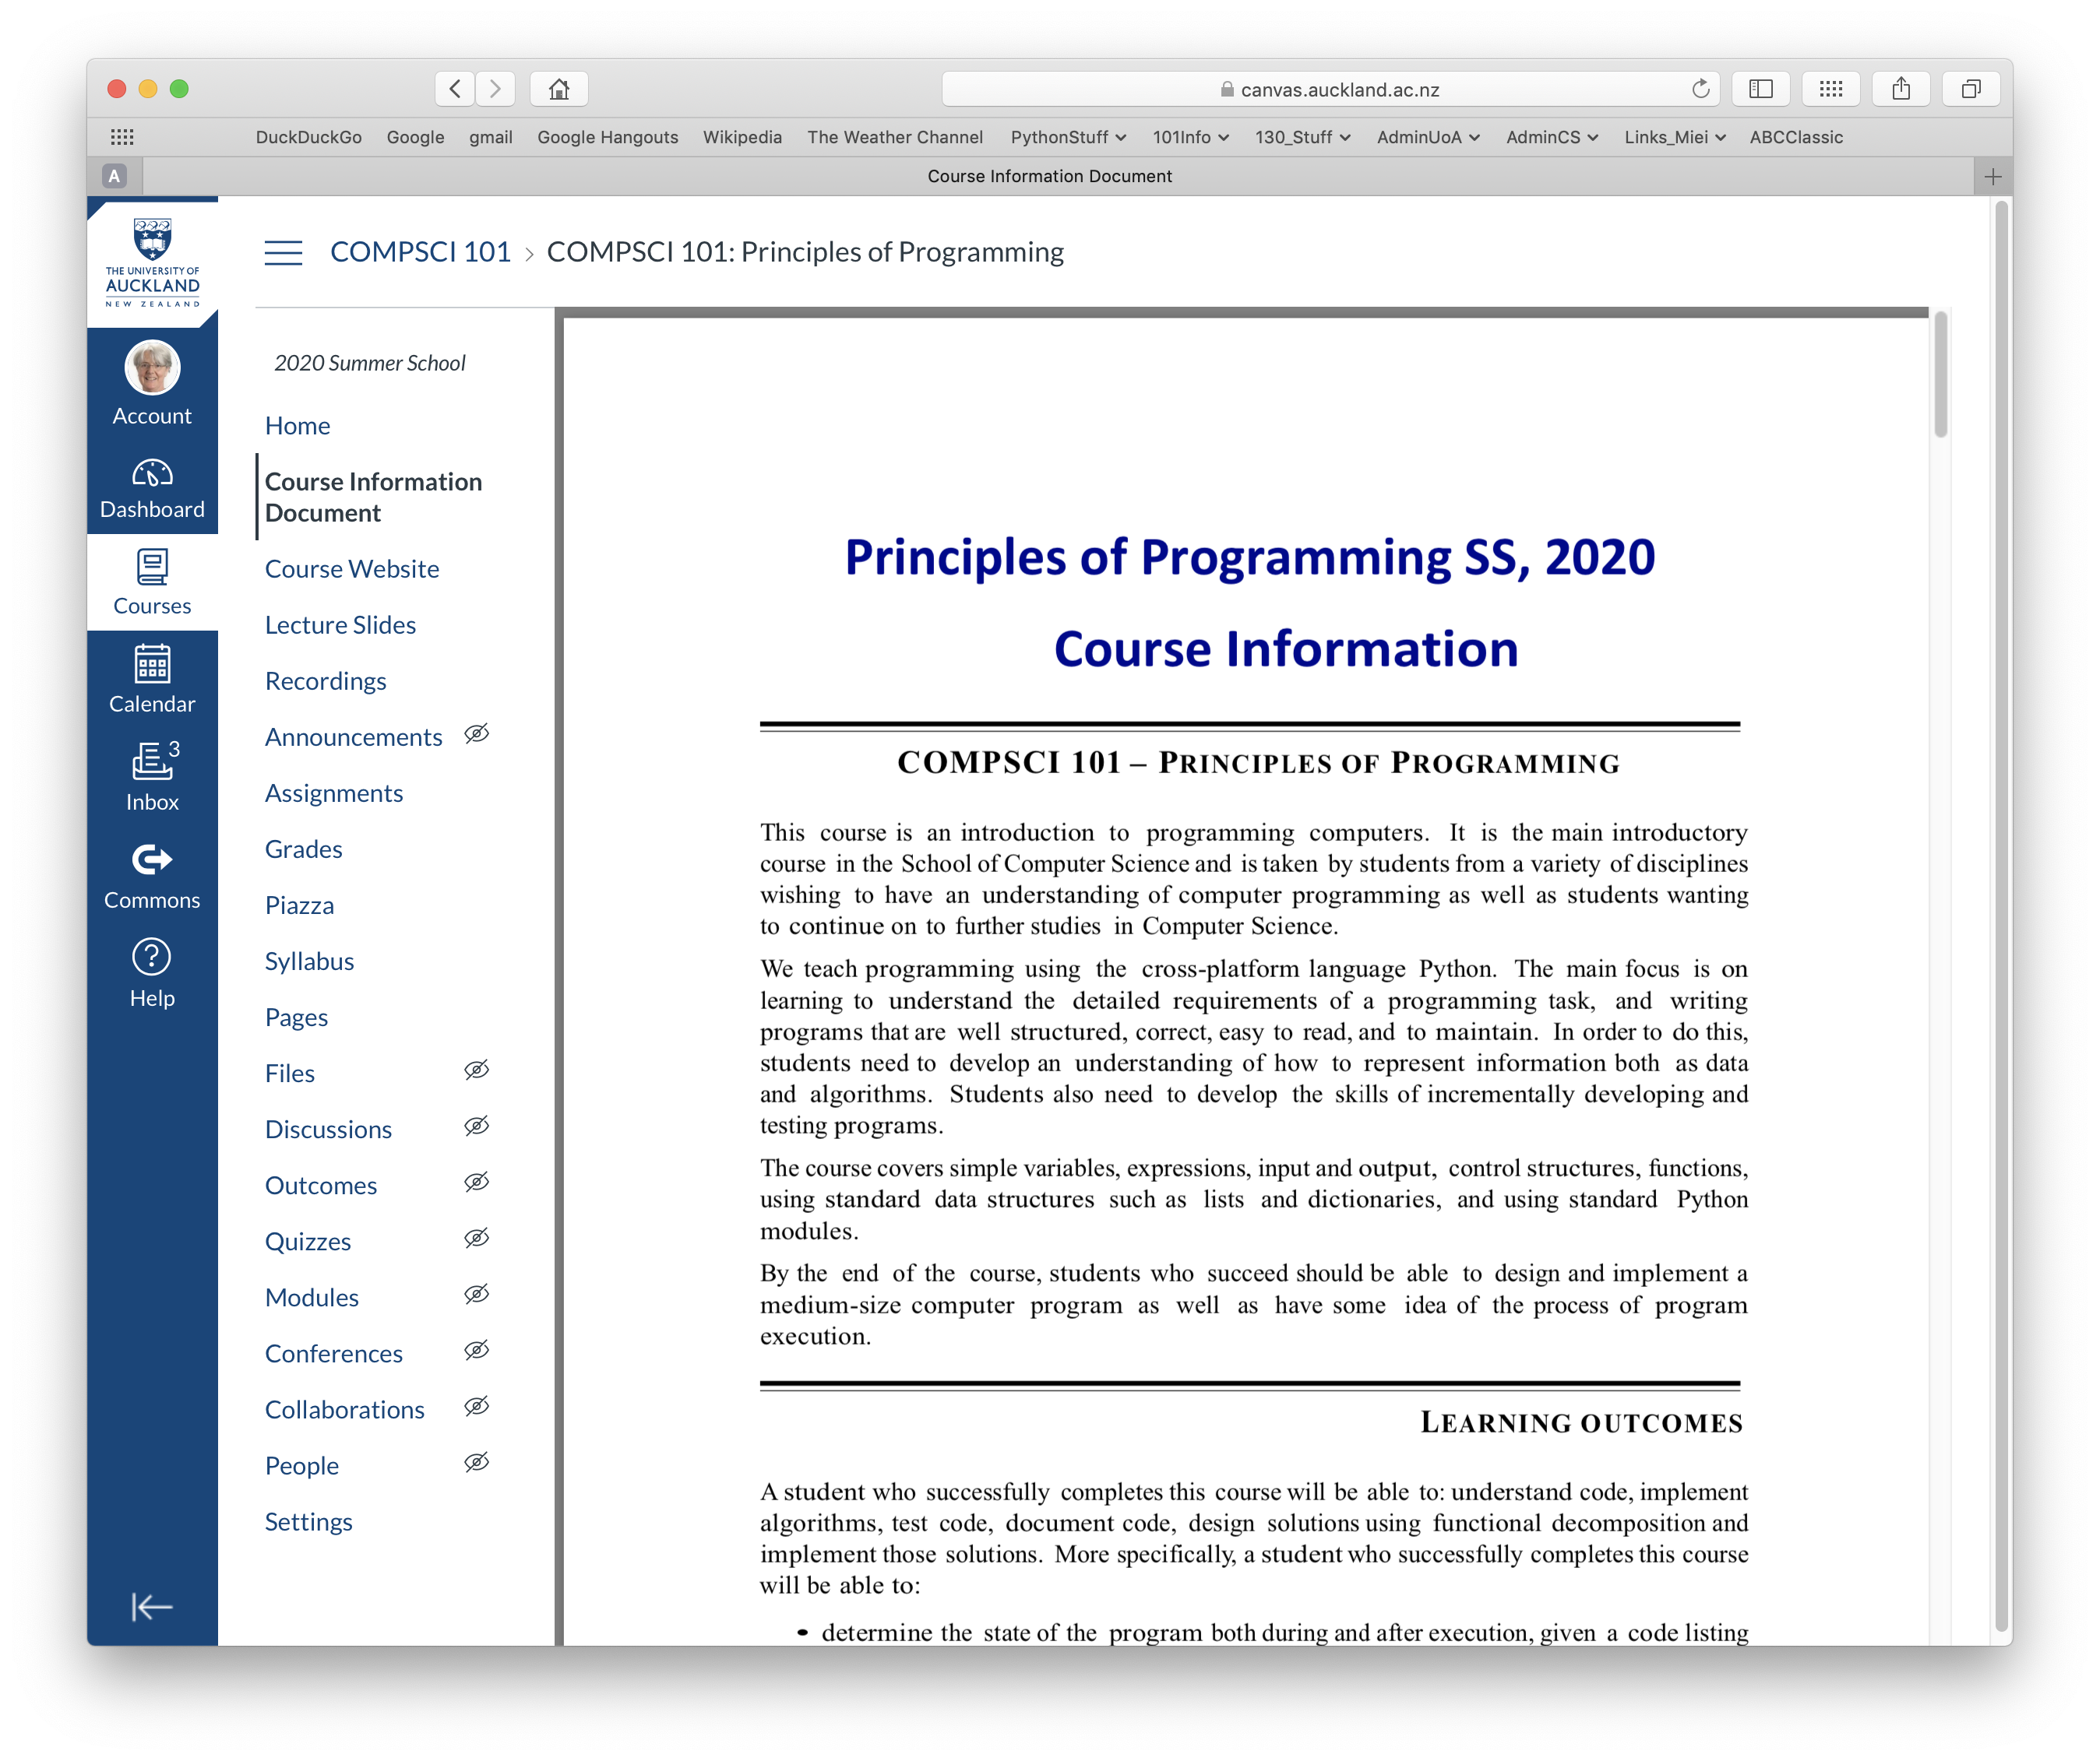
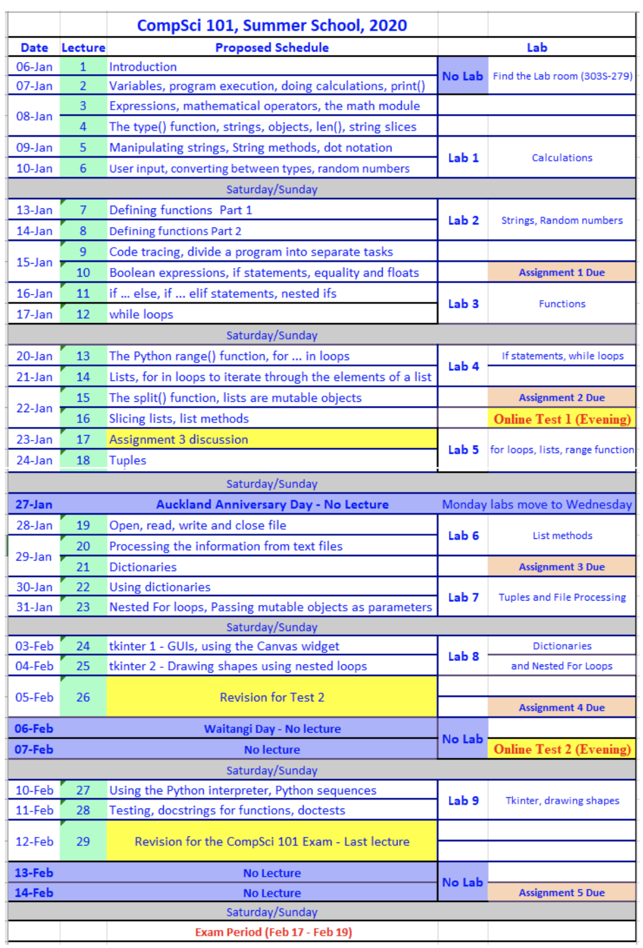
Lecture schedule
On the course information sheet there is a schedule of the lectures for CompSci 101.
Course Information Document
https://www.cs.auckland.ac.nz/courses/compsci101ssc/info/CourseInformation.pdf
Notes:
Change pic

Slide 11
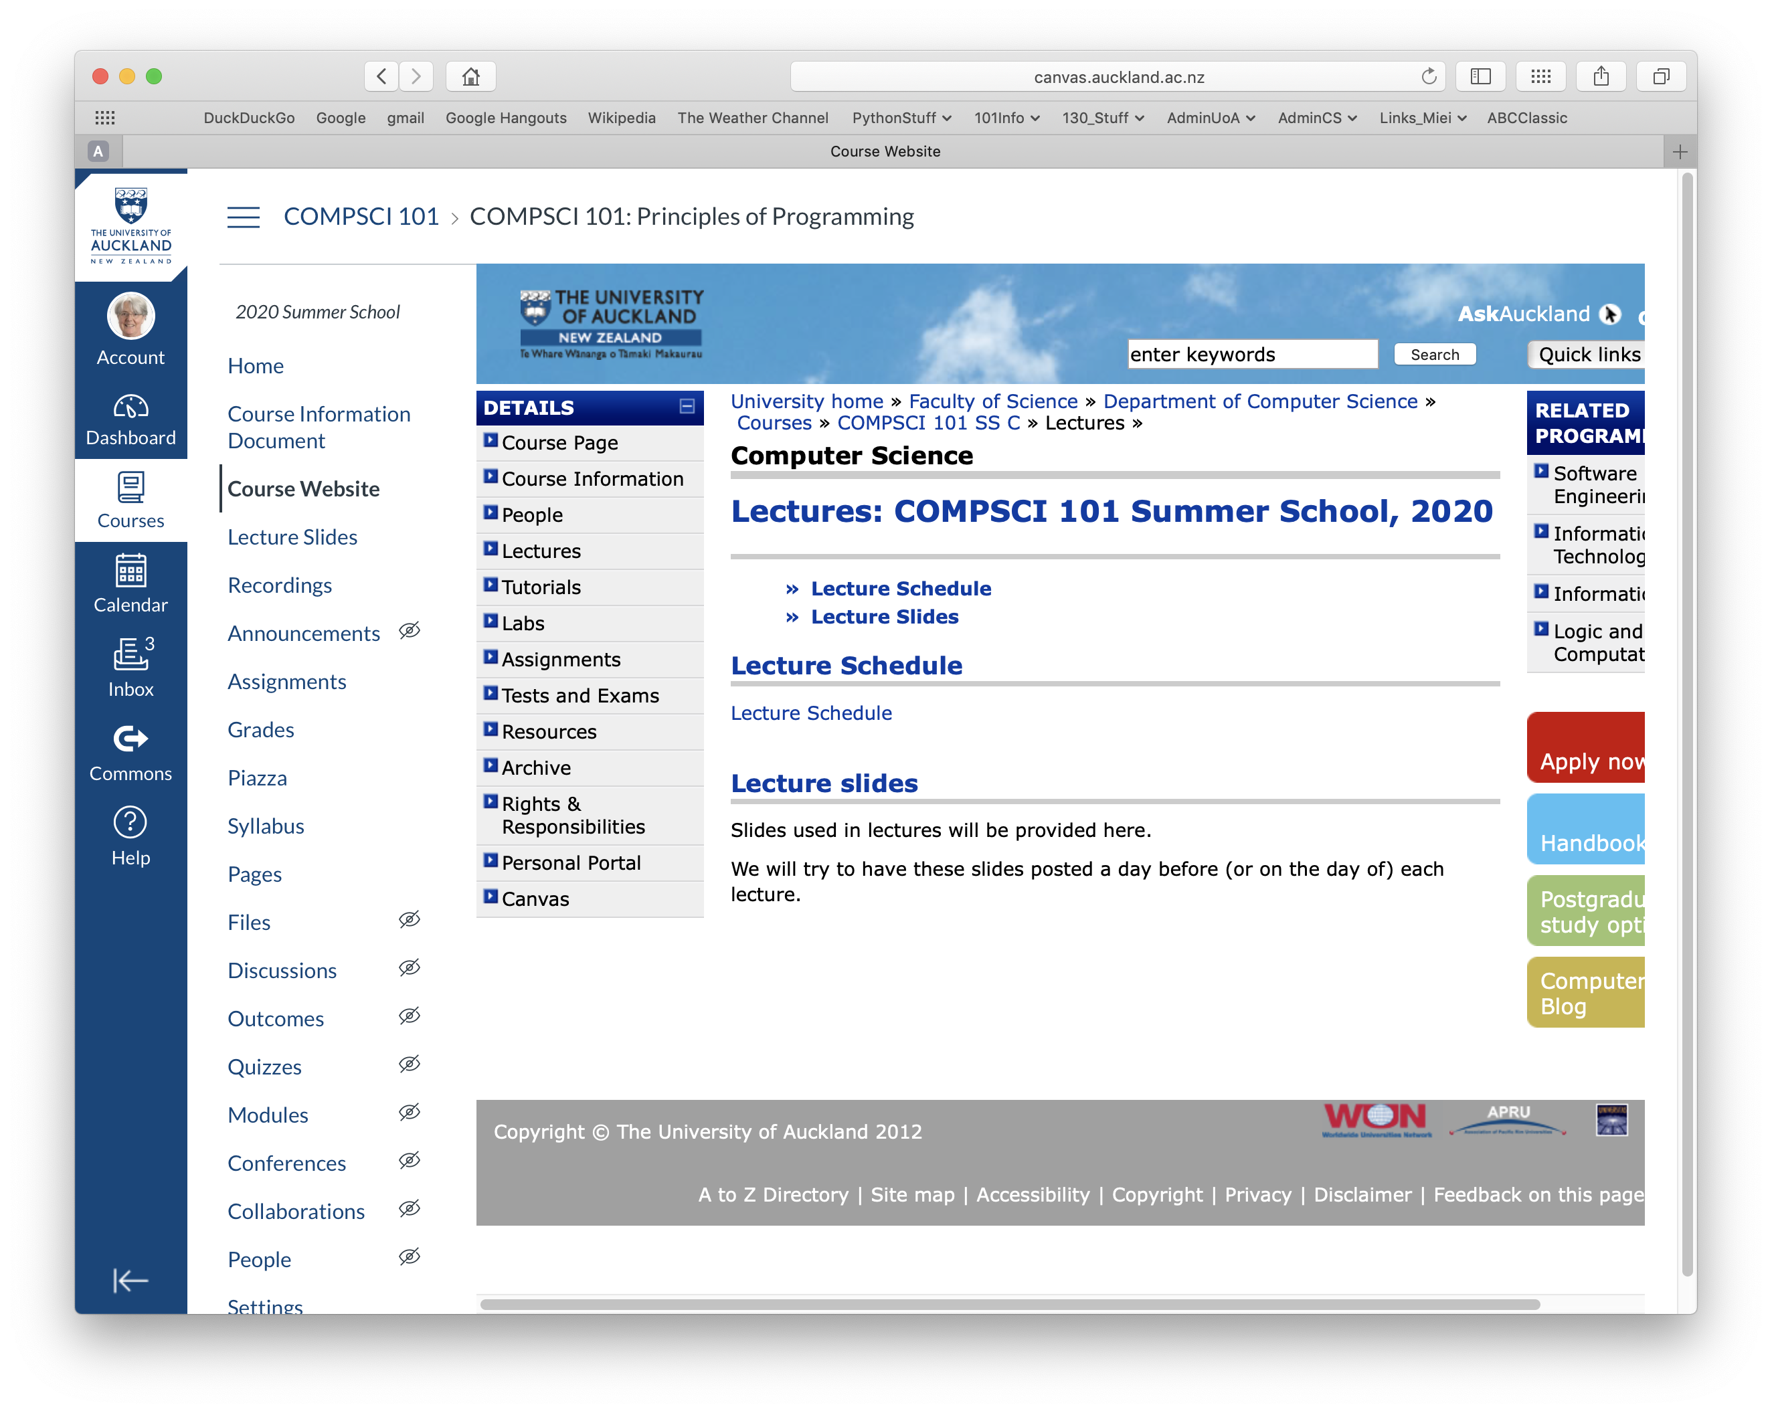
Lecture Slides
Lecture slides will be available on the web before each lecture.
Lectures
https://www.cs.auckland.ac.nz/courses/compsci101ssc/lectures
Notes:
Get there through Canvas. Change pic

Slide 12
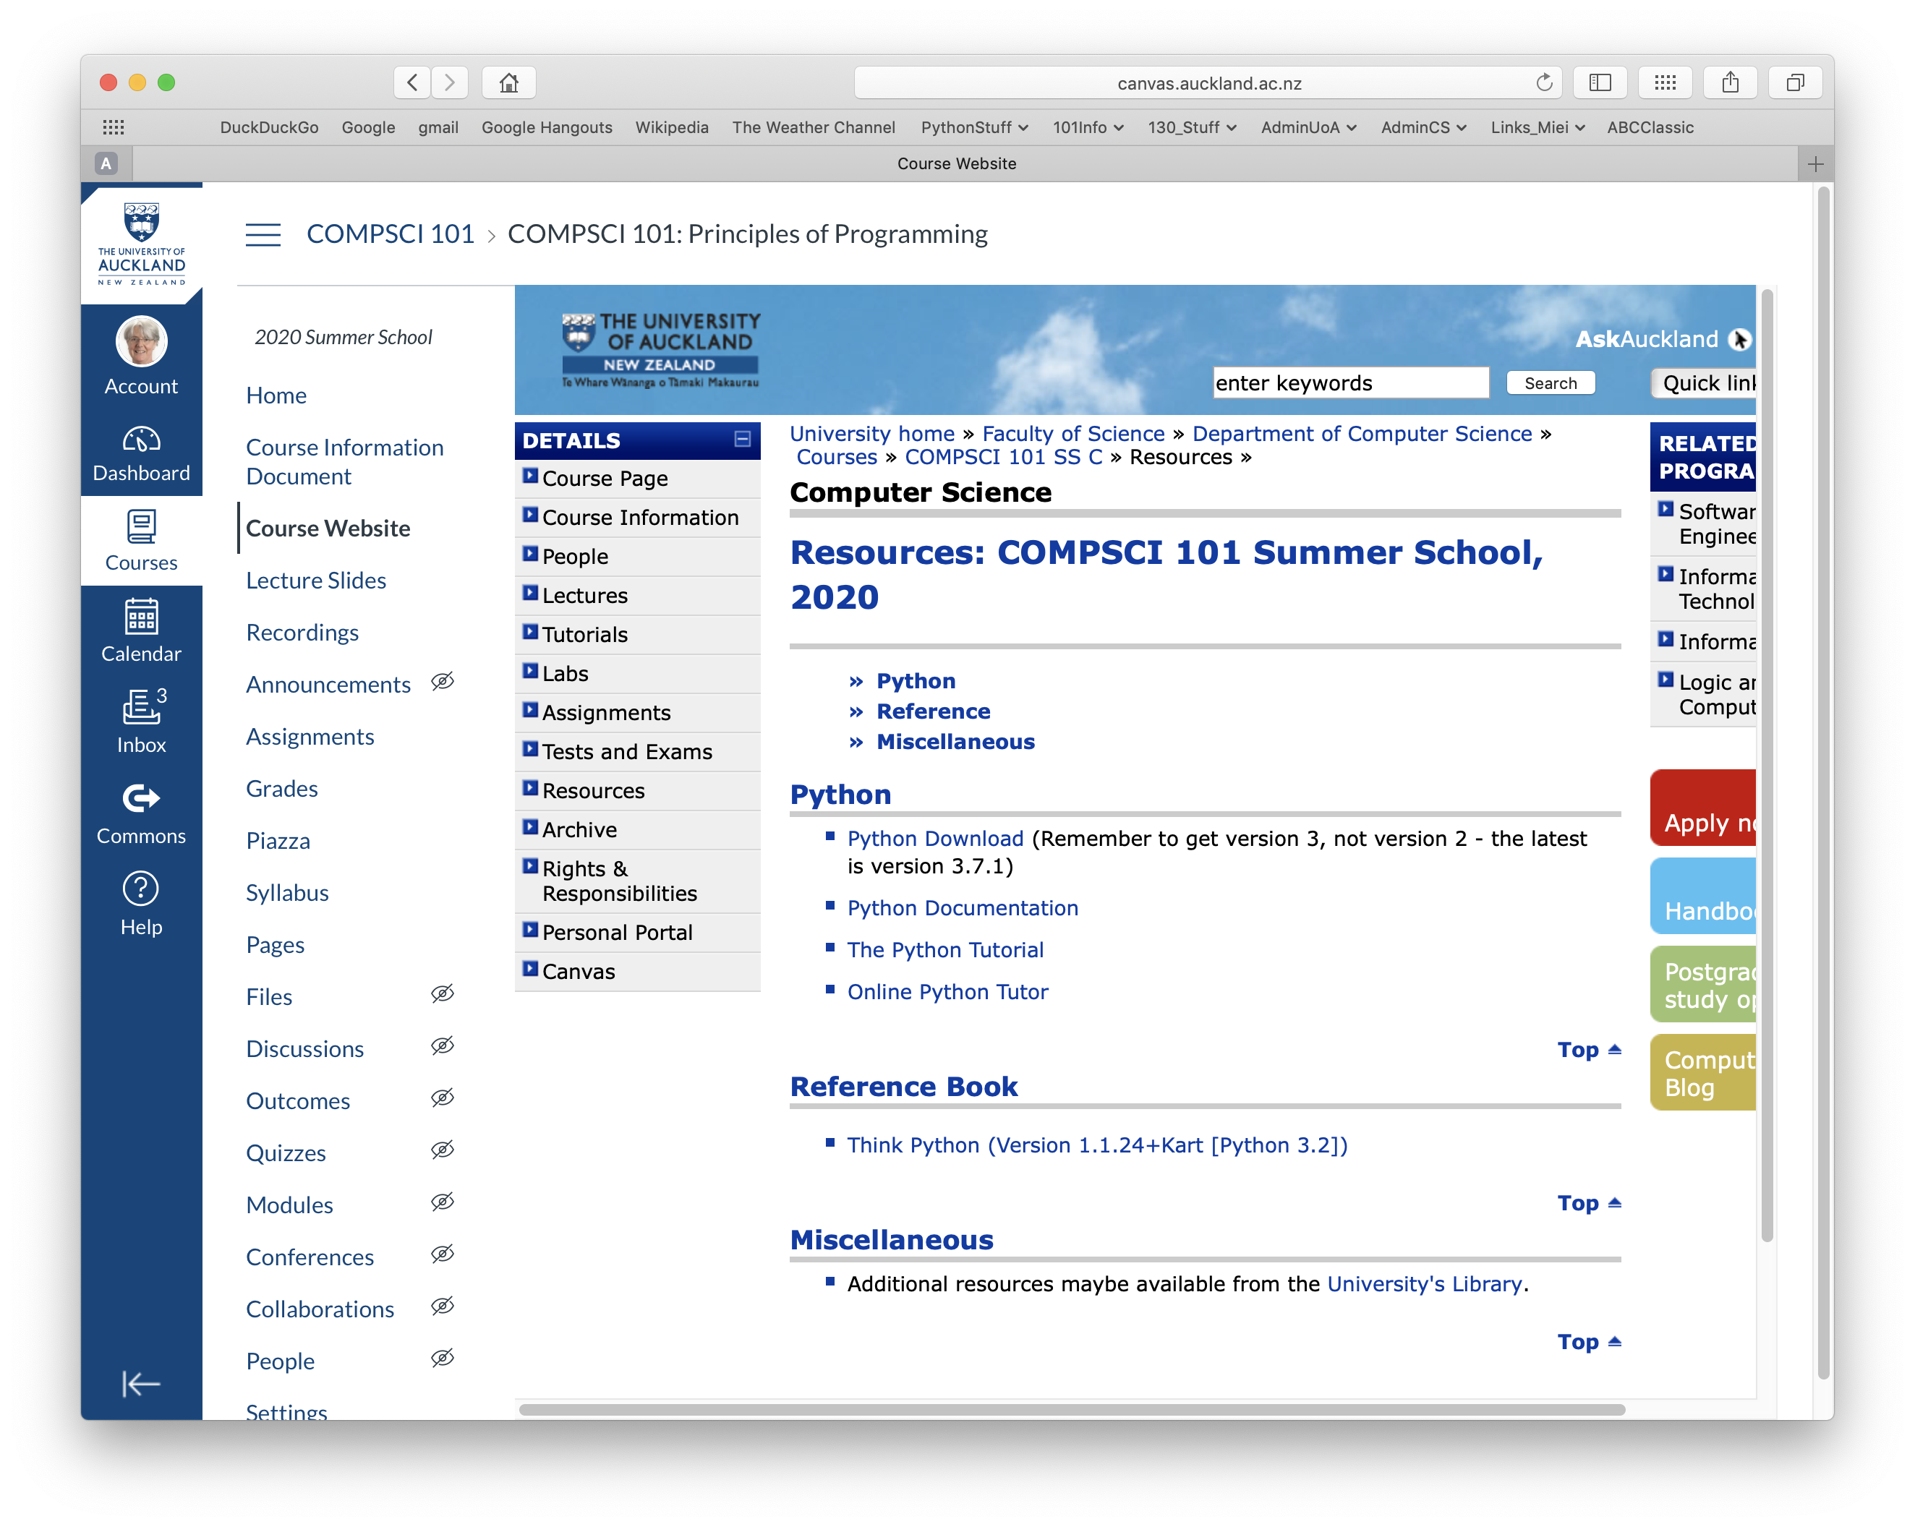
There is no textbook for CompSci 101
There is no textbook but we do have an online reference book,
Think Python – How to think like a computer scientist.
Please be aware that we are teaching the CompSci 101 material in a different order to the ordering in this book. This book is a reference book, not a textbook for this course.
Resources
Online Reference Book
https://www.cs.auckland.ac.nz/courses/compsci101ssc/resources/
Notes:
Change pic

Slide 13
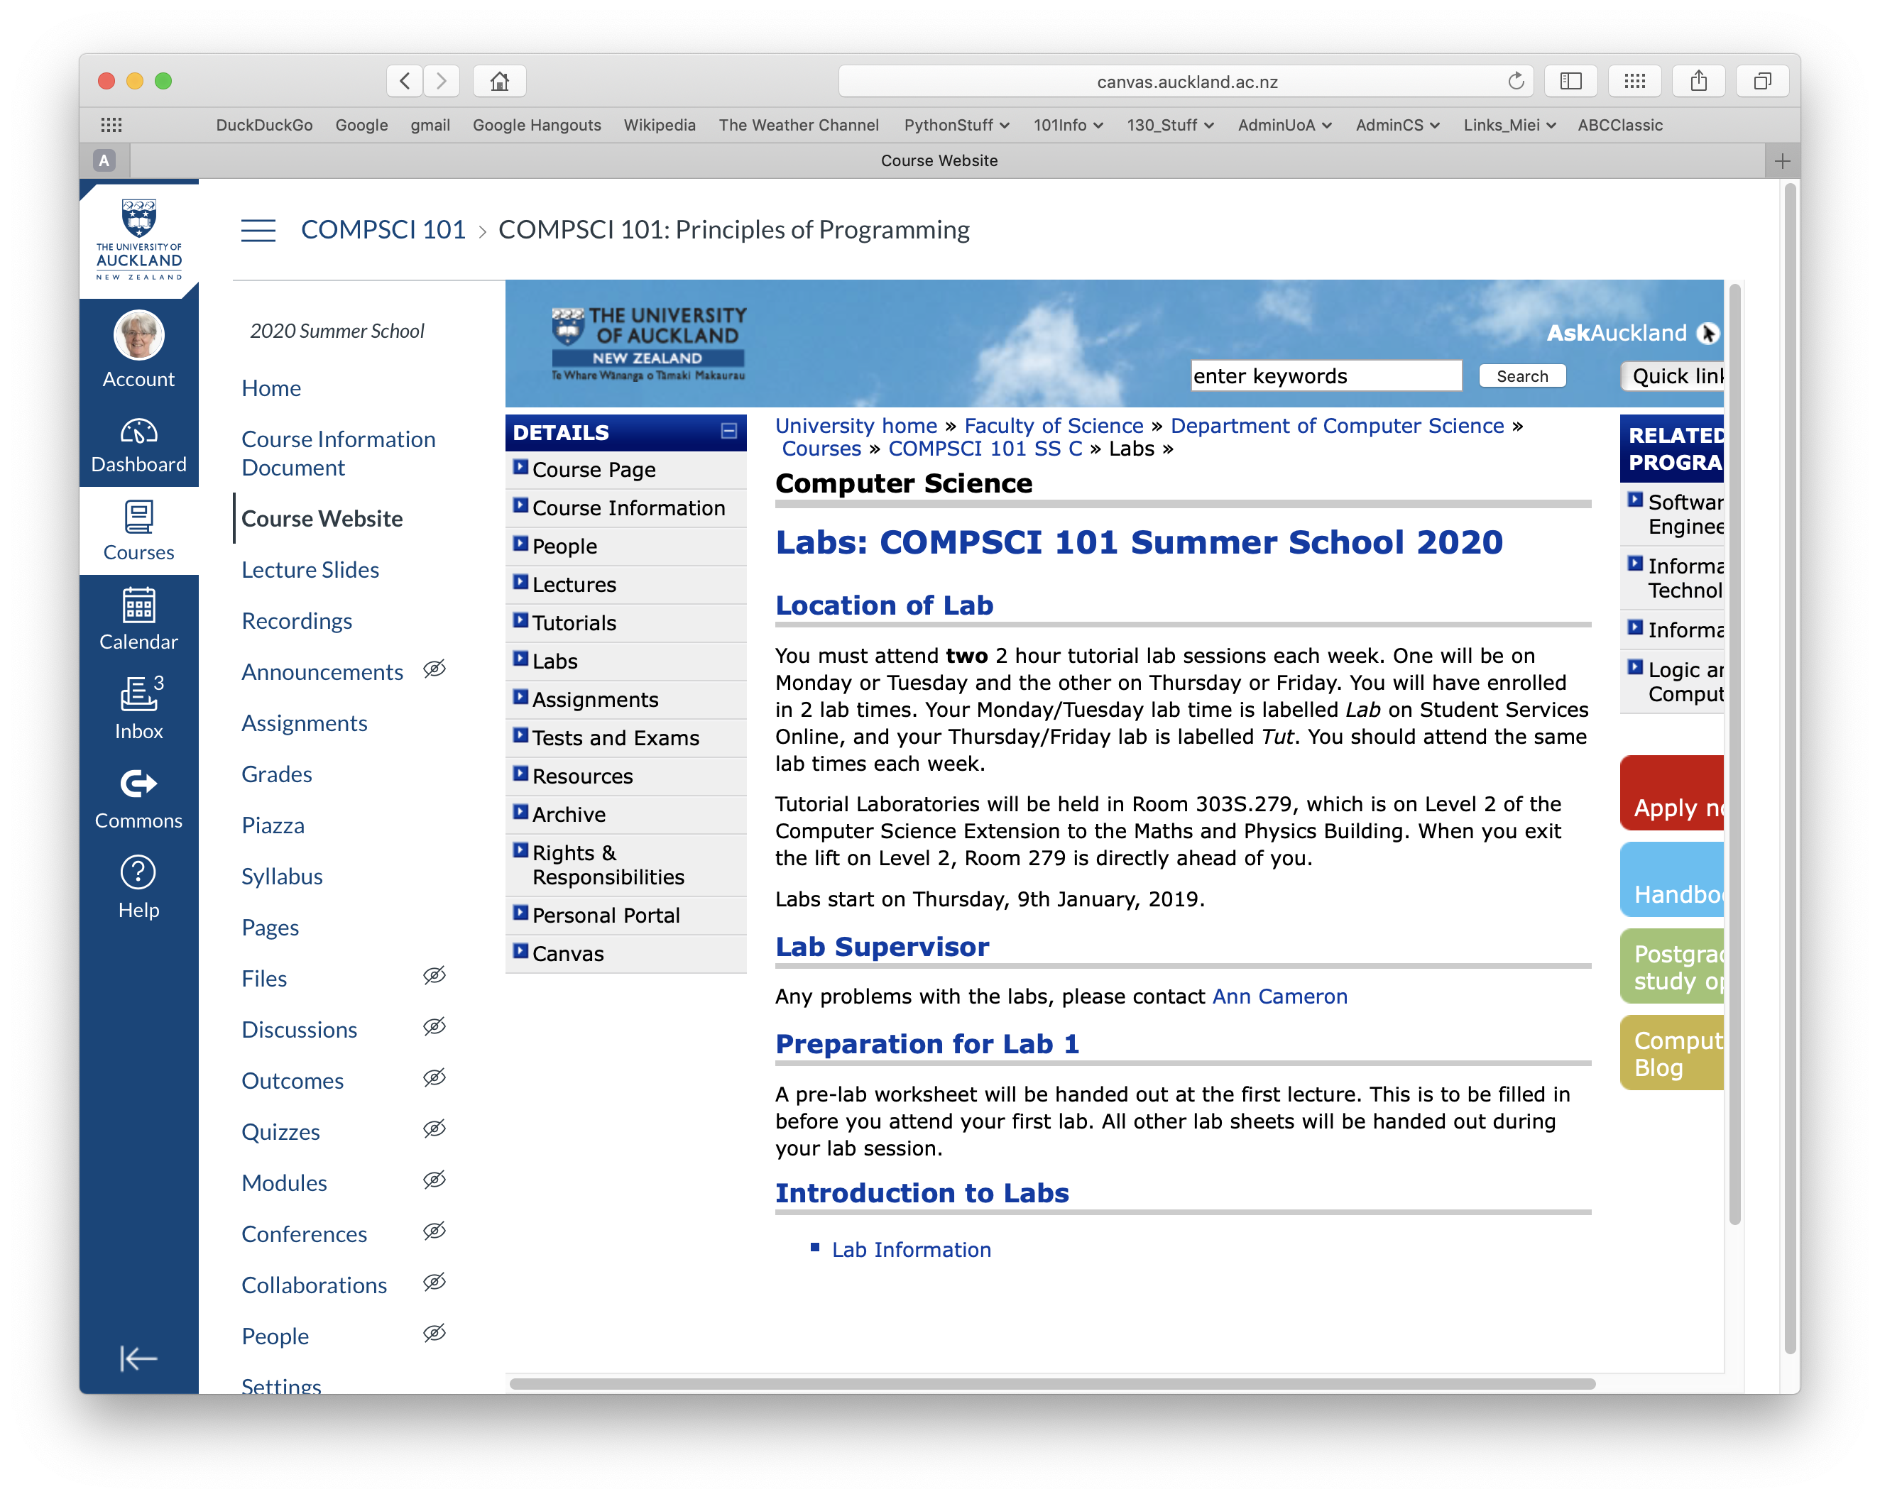
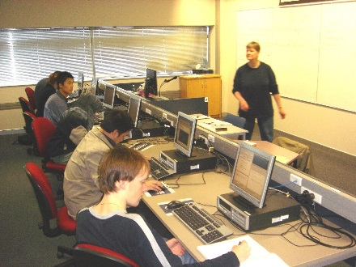
Labs
Labs start this week: Thursday January 9/Friday January 10
You must attend two 2 hour tutorial lab sessions each week. One will be on Monday or Tuesday and the other on Thursday or Friday. You will have enrolled in 2 lab times. Your Monday/Tuesday lab time is labelled Lab on Student Services Online, and your Thursday/Friday lab is labelled Tut. You should attend the same lab times each week.
Labs are held in room 279 (Building 303S) which is on the second floor of the
Computer Science building.
Labs
https://www.cs.auckland.ac.nz/courses/compsci101ssc/labs/
Notes:
Take you to the lab after the lecture

Slide 14
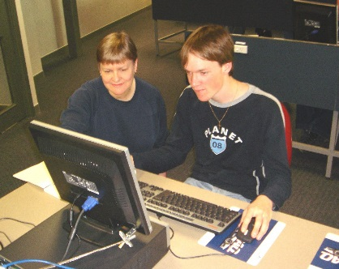
More about labs
Labs start this week:
Thursday January 9/Friday January 10
There are 9 labs and each lab is worth 1% of your final mark.
At your lab time you will be given programming problems to solve within the 2 hours for your lab.
Labs
https://www.cs.auckland.ac.nz/courses/compsci101ssc/labs/

Slide 15
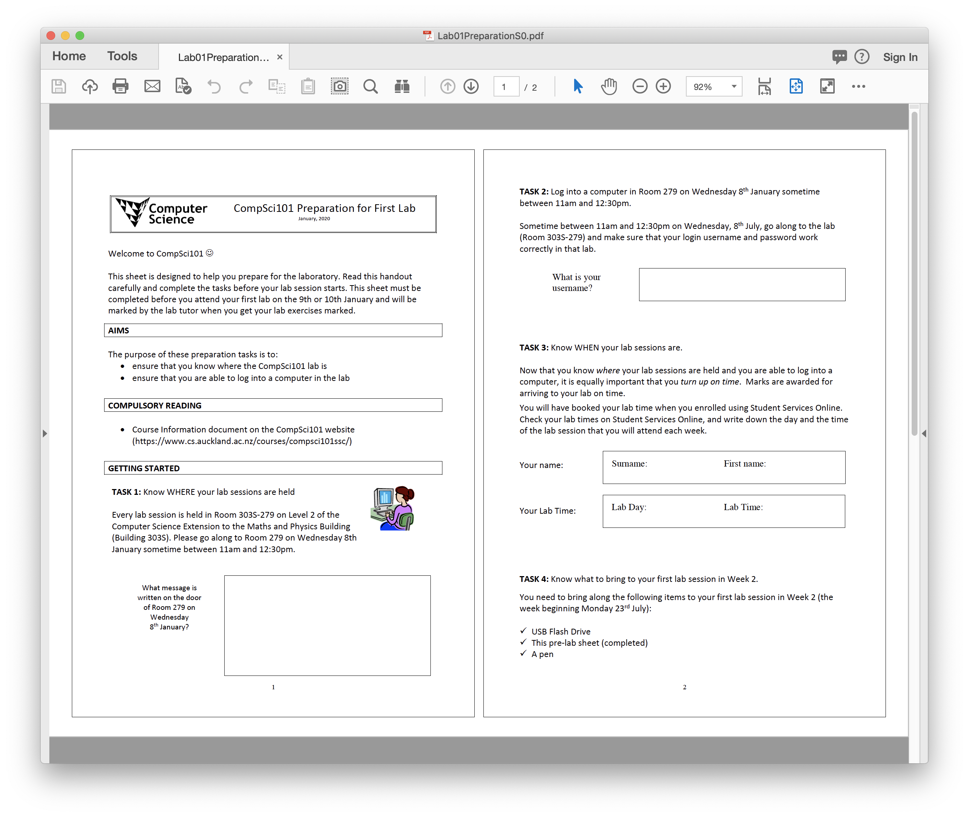
Before the First Lab
Visit the lab on Wednesday straight after the lecture.
Before the first lab you need to complete the lab preparation sheet (I will hand this out).
In order to complete the sheet you need to visit the CompSci 101 lab. Immediately after the lecture on Wednesday I will be taking people across to the CompSci 101 lab.
Notes:
Change pic

Slide 16
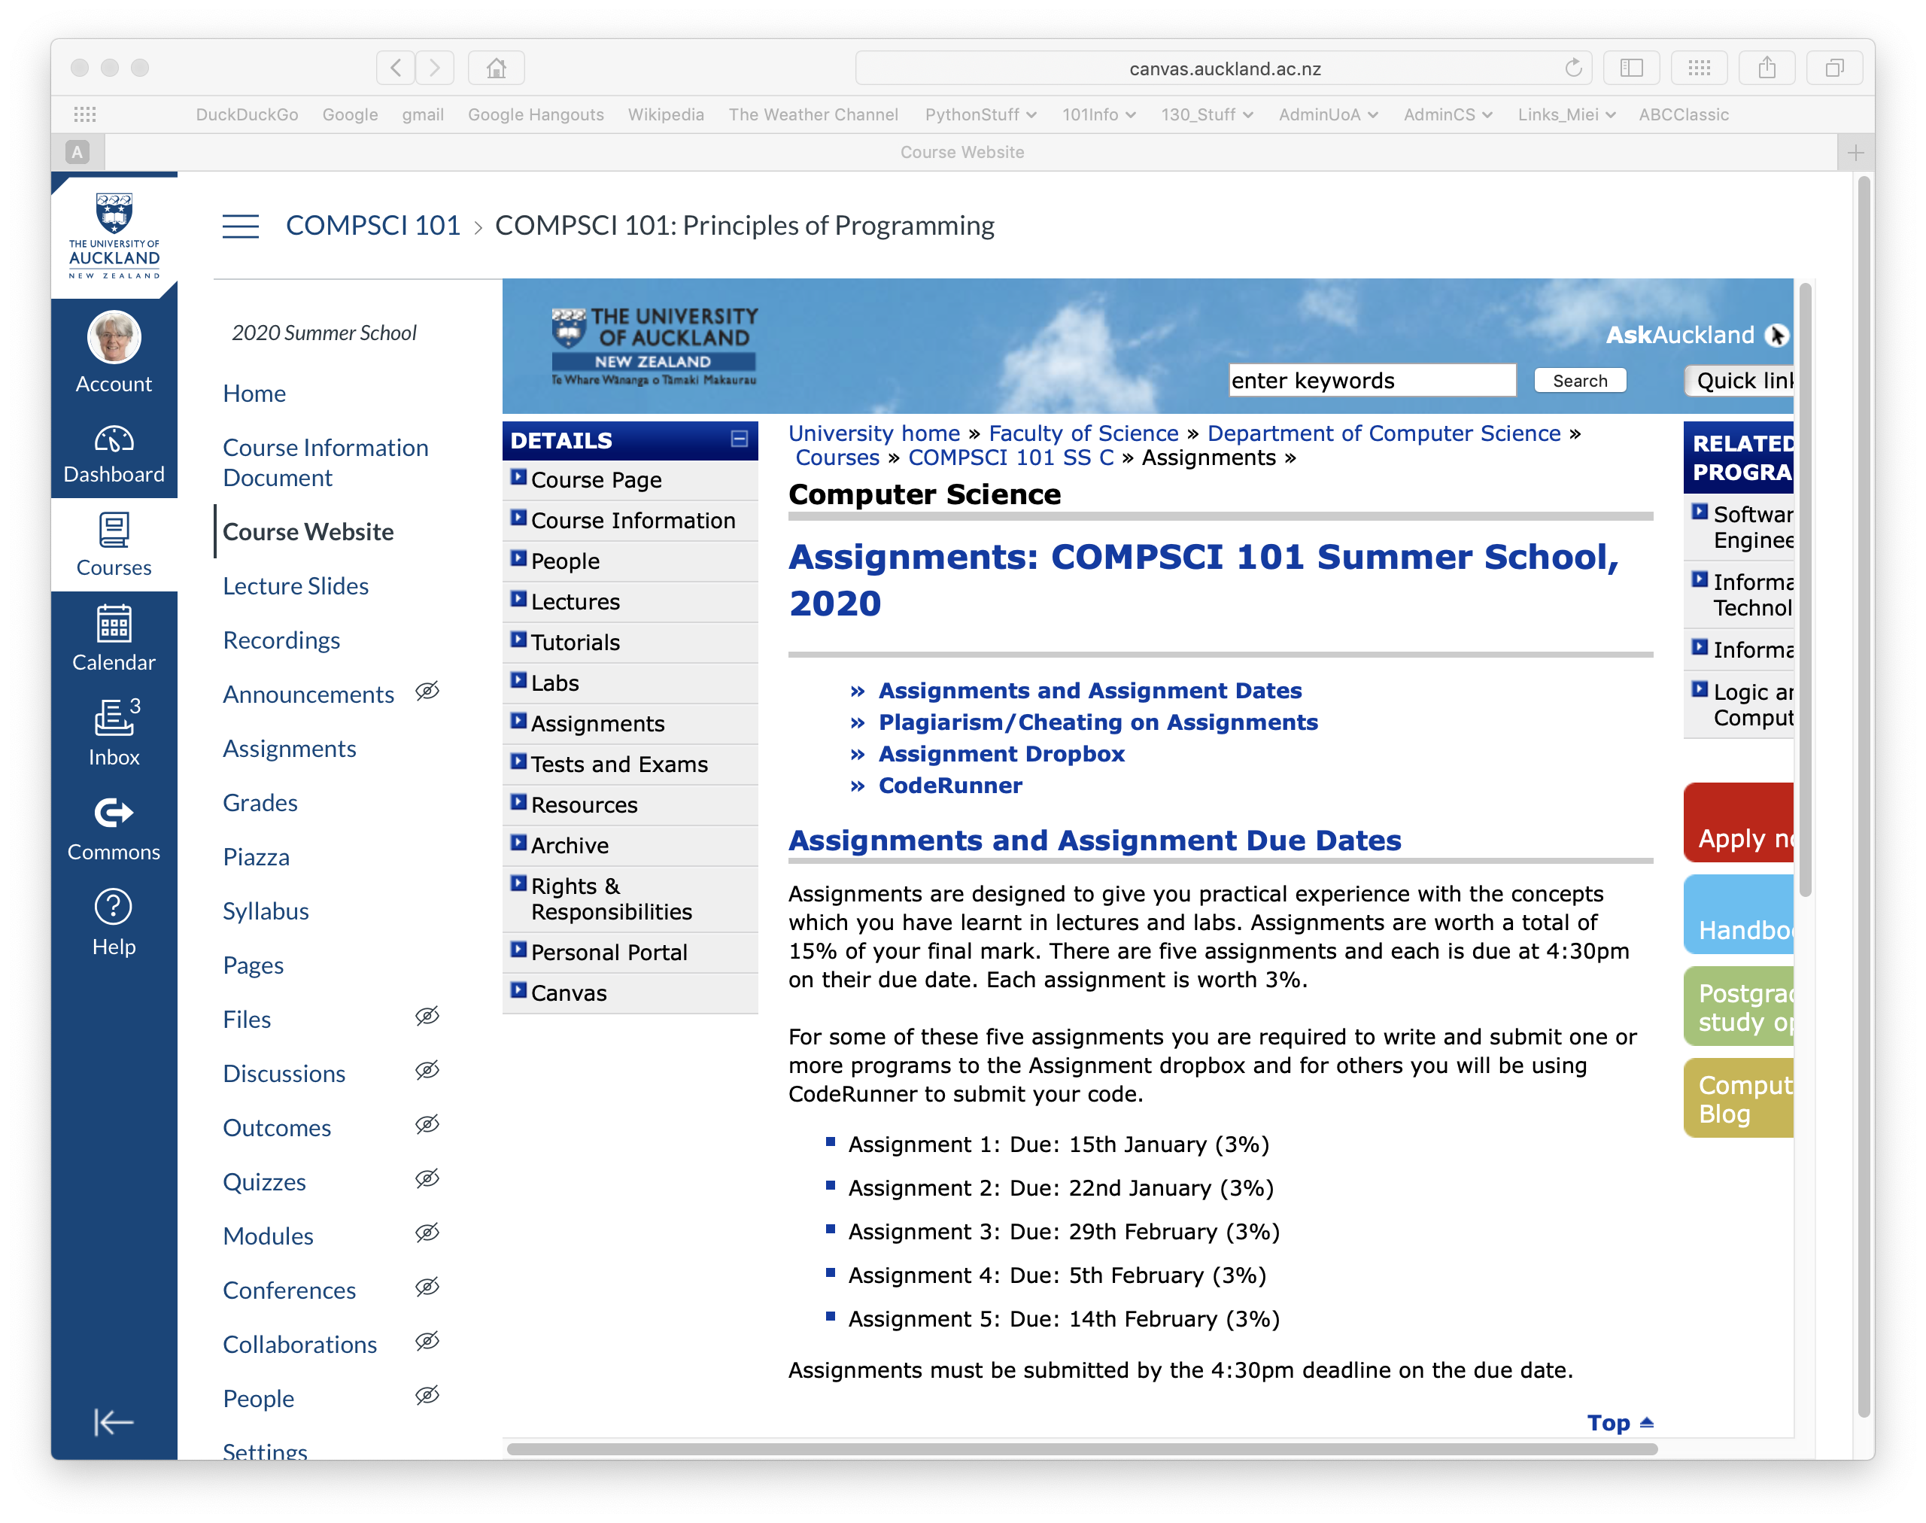
Assignments
Assignments give you the experience of solving problems on your own.
The assignments are worth 15% of your final mark.
Never share your code.
Assignments
Solve the problem on your own – discuss the assignment with others but never share code.
https://www.cs.auckland.ac.nz/courses/compsci101ssc/assignments/

Slide 17
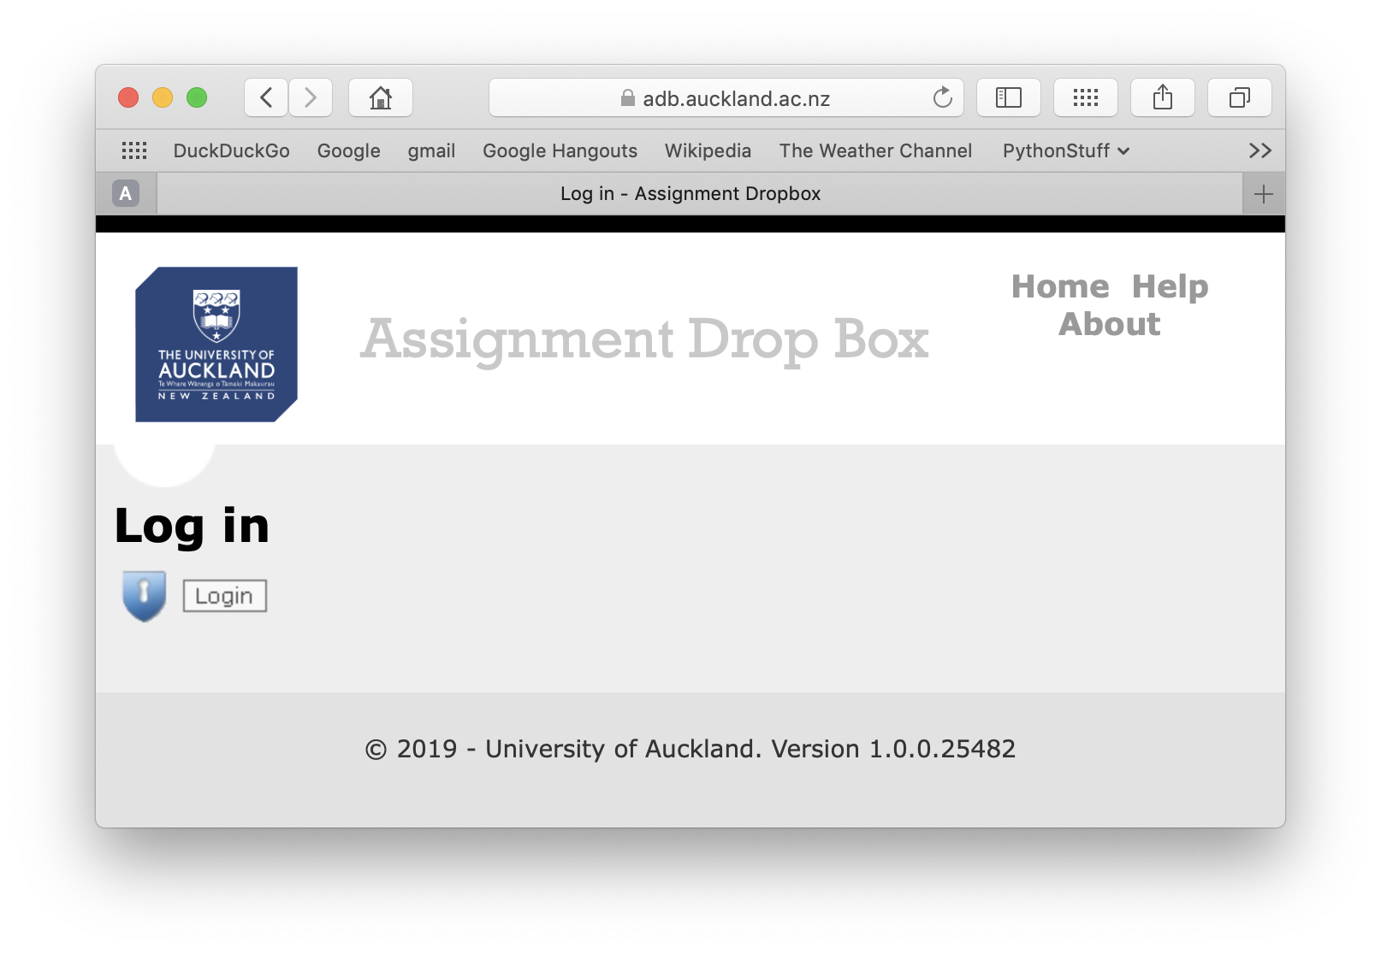
Assignments
There are 5 assignments in total worth 15% of your final mark.
All assignments are due at 4:30pm on the due date.
For parts of these five assignments, you are required to write and submit one or more programs.
For these parts of the five assignments your programs are handed in using the
Assignment Drop Box:
https://adb.auckland.ac.nz/Home/

Slide 18
CodeRunner3
The CodeRunner3 tool is designed to help you practise by presenting you with a set of coding and other exercises. Submissions are graded by running a series of test cases on your code (or short answers) in a sandbox and comparing the output of your code (or short answers) with the expected output. Coderunner3 uses the Moodle learning system.
Information about using CodeRunner3 is available on CompSci 101 Assignments web page:
https://www.coderunner3.auckland.ac.nz/moodle/
https://www.cs.auckland.ac.nz/courses/compsci101ssc/assignments/

Slide 19
Assignments - CodeRunner
There are 5 assignments in total worth 15% of your final mark.
All assignments are due at 4:30pm on the due date.
For parts of these five assignments, you are required to use CodeRunner3. You can log into Coderunner3 from the CompSci 101 Assignments website:
https://www.cs.auckland.ac.nz/courses/compsci101ssc/assignments/

Slide 20
Timed CodeRunner Questions
There are 9 timed Coderunner3 exercises. Each question (or set of questions) is worth 1% but only your best 6 marks will be counted towards your final grade.
These exercises are timed which means that you will have to develop and implement your solution within a certain amount of time (usually 15 minutes). Each of these exercises will be closely aligned to each lab.
The timed CodeRunner questions (or set of questions) will become available after the end of the sessions for each lab (i.e., after 5pm on Tuesdays and after 5pm on Fridays) and each timed question will be available for twenty four hours only.

Slide 21
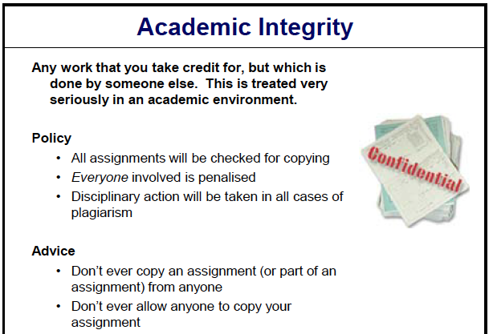
Plagiarism
Plagiarism
Plagiarism: Any work that you take credit for, but which is done by someone else. This is treated very seriously in an academic environment.
https://www.academicintegrity.auckland.ac.nz

Slide 22
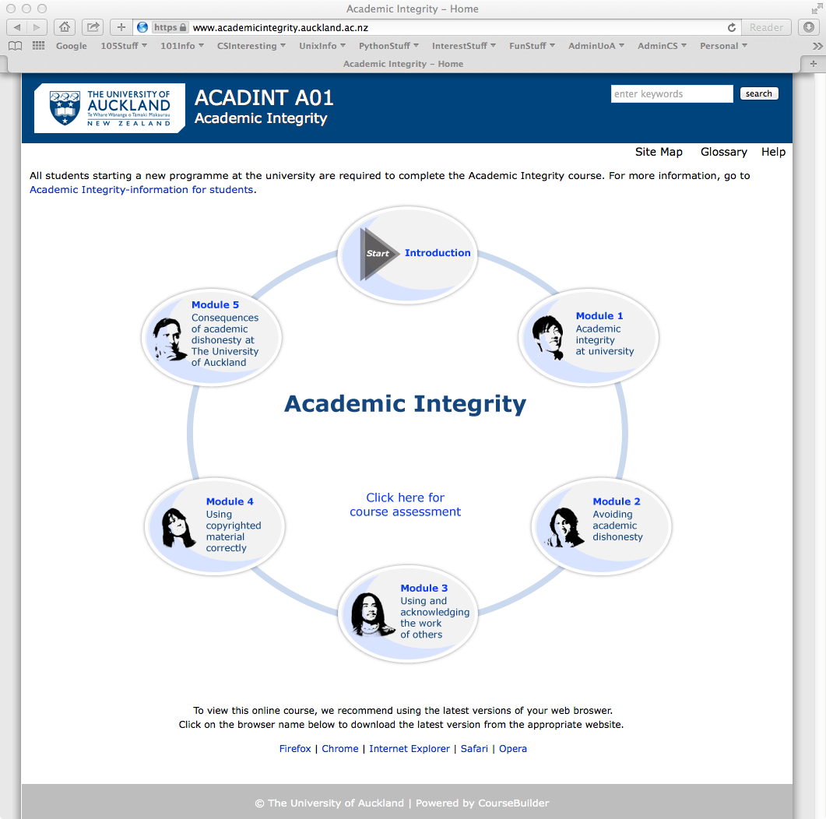
Academic Integrity
https://www.academicintegrity.auckland.ac.nz

Slide 23
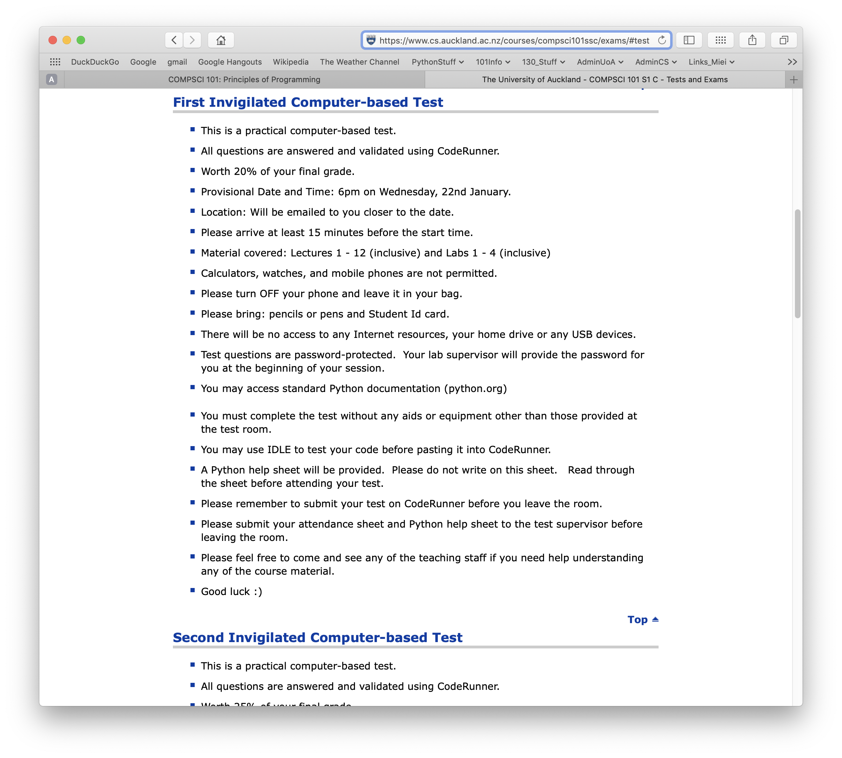
Two Invigilated Online Tests
There are two practical invigilated tests. The tests are answered and validated on CodeRunner.
Test 1: 6pm on Wednesday, 22nd January - 20% of your final mark
Test 2: 6pm on Friday, 7th February - 25% of your final mark
The tests are 90 minutes.
You should arrive 15 minutes
before the test start time.
There is more information about
the invigilated tests on the
"Tests and Exams" web page:
https://www.cs.auckland.ac.nz/courses/compsci101ssc/exams/
Notes:
Large Chem

Slide 24
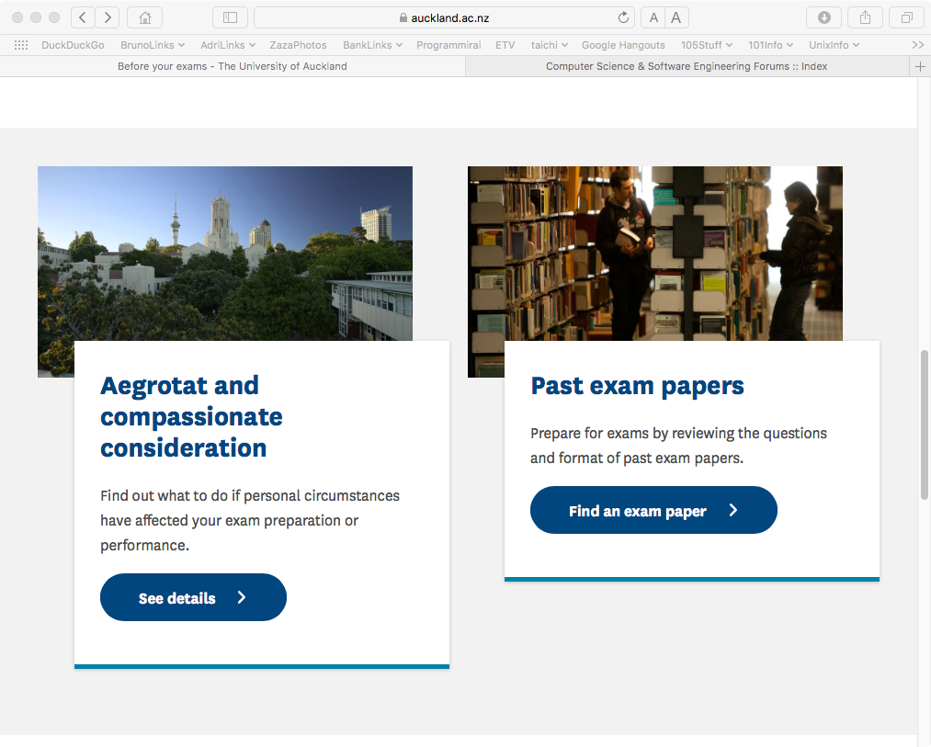
Written Exam
The exam is worth 25% of your final mark.
Links to information about missed exams, aegrotats, etc.
…
https://www.auckland.ac.nz/en/students/academic-information/exams-and-final-results/during-exams.html
Notes:
Change pic

Slide 25
Passing CompSci 101
Assessment
Assignments, timed questions, labs – 30%
Two online test - 45%
Exam - 25%
Labs 9%
Assignments 15%
Coderunner 6%
Test 1 20%
Test 2 25%
Exam 25%
To pass the course, you need
• to pass the invigilated online tests component, you need to achieve a pass (i.e., at least 22.5 marks out of 45) in the combined total of both tests.
• to pass the invigilated final written exam, you need to achieve a pass (i.e., at least 12.5 marks out of 25).
• an overall mark of at least 50% out of the full course total of 100%

Slide 26
The CompSci 101 website
Most of the resources you will need (e.g., lecture slides, lab material, assignments, course information) can be found on the CompSci 101 website:
Can be accessed from Canvas:
https://www.cs.auckland.ac.nz/courses/compsci101ssc/
https://canvas.auckland.ac.nz
Course Information Document
People
Lectures
Labs
Assignments
Tests, Exams
Notes:
Change pic

Slide 27
Canvas
On Canvas you will find:
• your marks
• class announcements
• lecture recordings
• a link to the CompSci 101 website
https://canvas.auckland.ac.nz
Notes:
Formal languages are languages that are designed by people for specific applications. For example,
the notation that mathematicians use is a formal language that is particularly good at denoting relationships
among numbers and symbols. Chemists use a formal language to represent the chemical
structure of molecules. And most importantly:
Programming languages are formal languages that have been designed to express
computations.

Slide 28
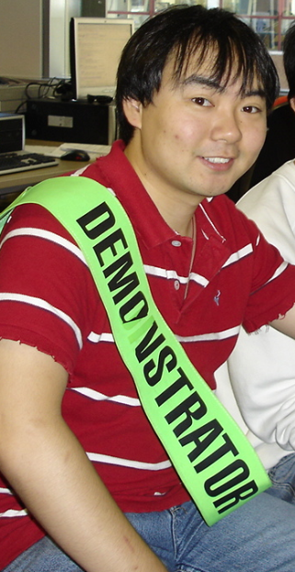
Computing resources
Undergraduate Labs:
There are demonstrators in these labs to help you
GCL (room 303S.G91) – Ground Floor Computer Lab

Slide 29
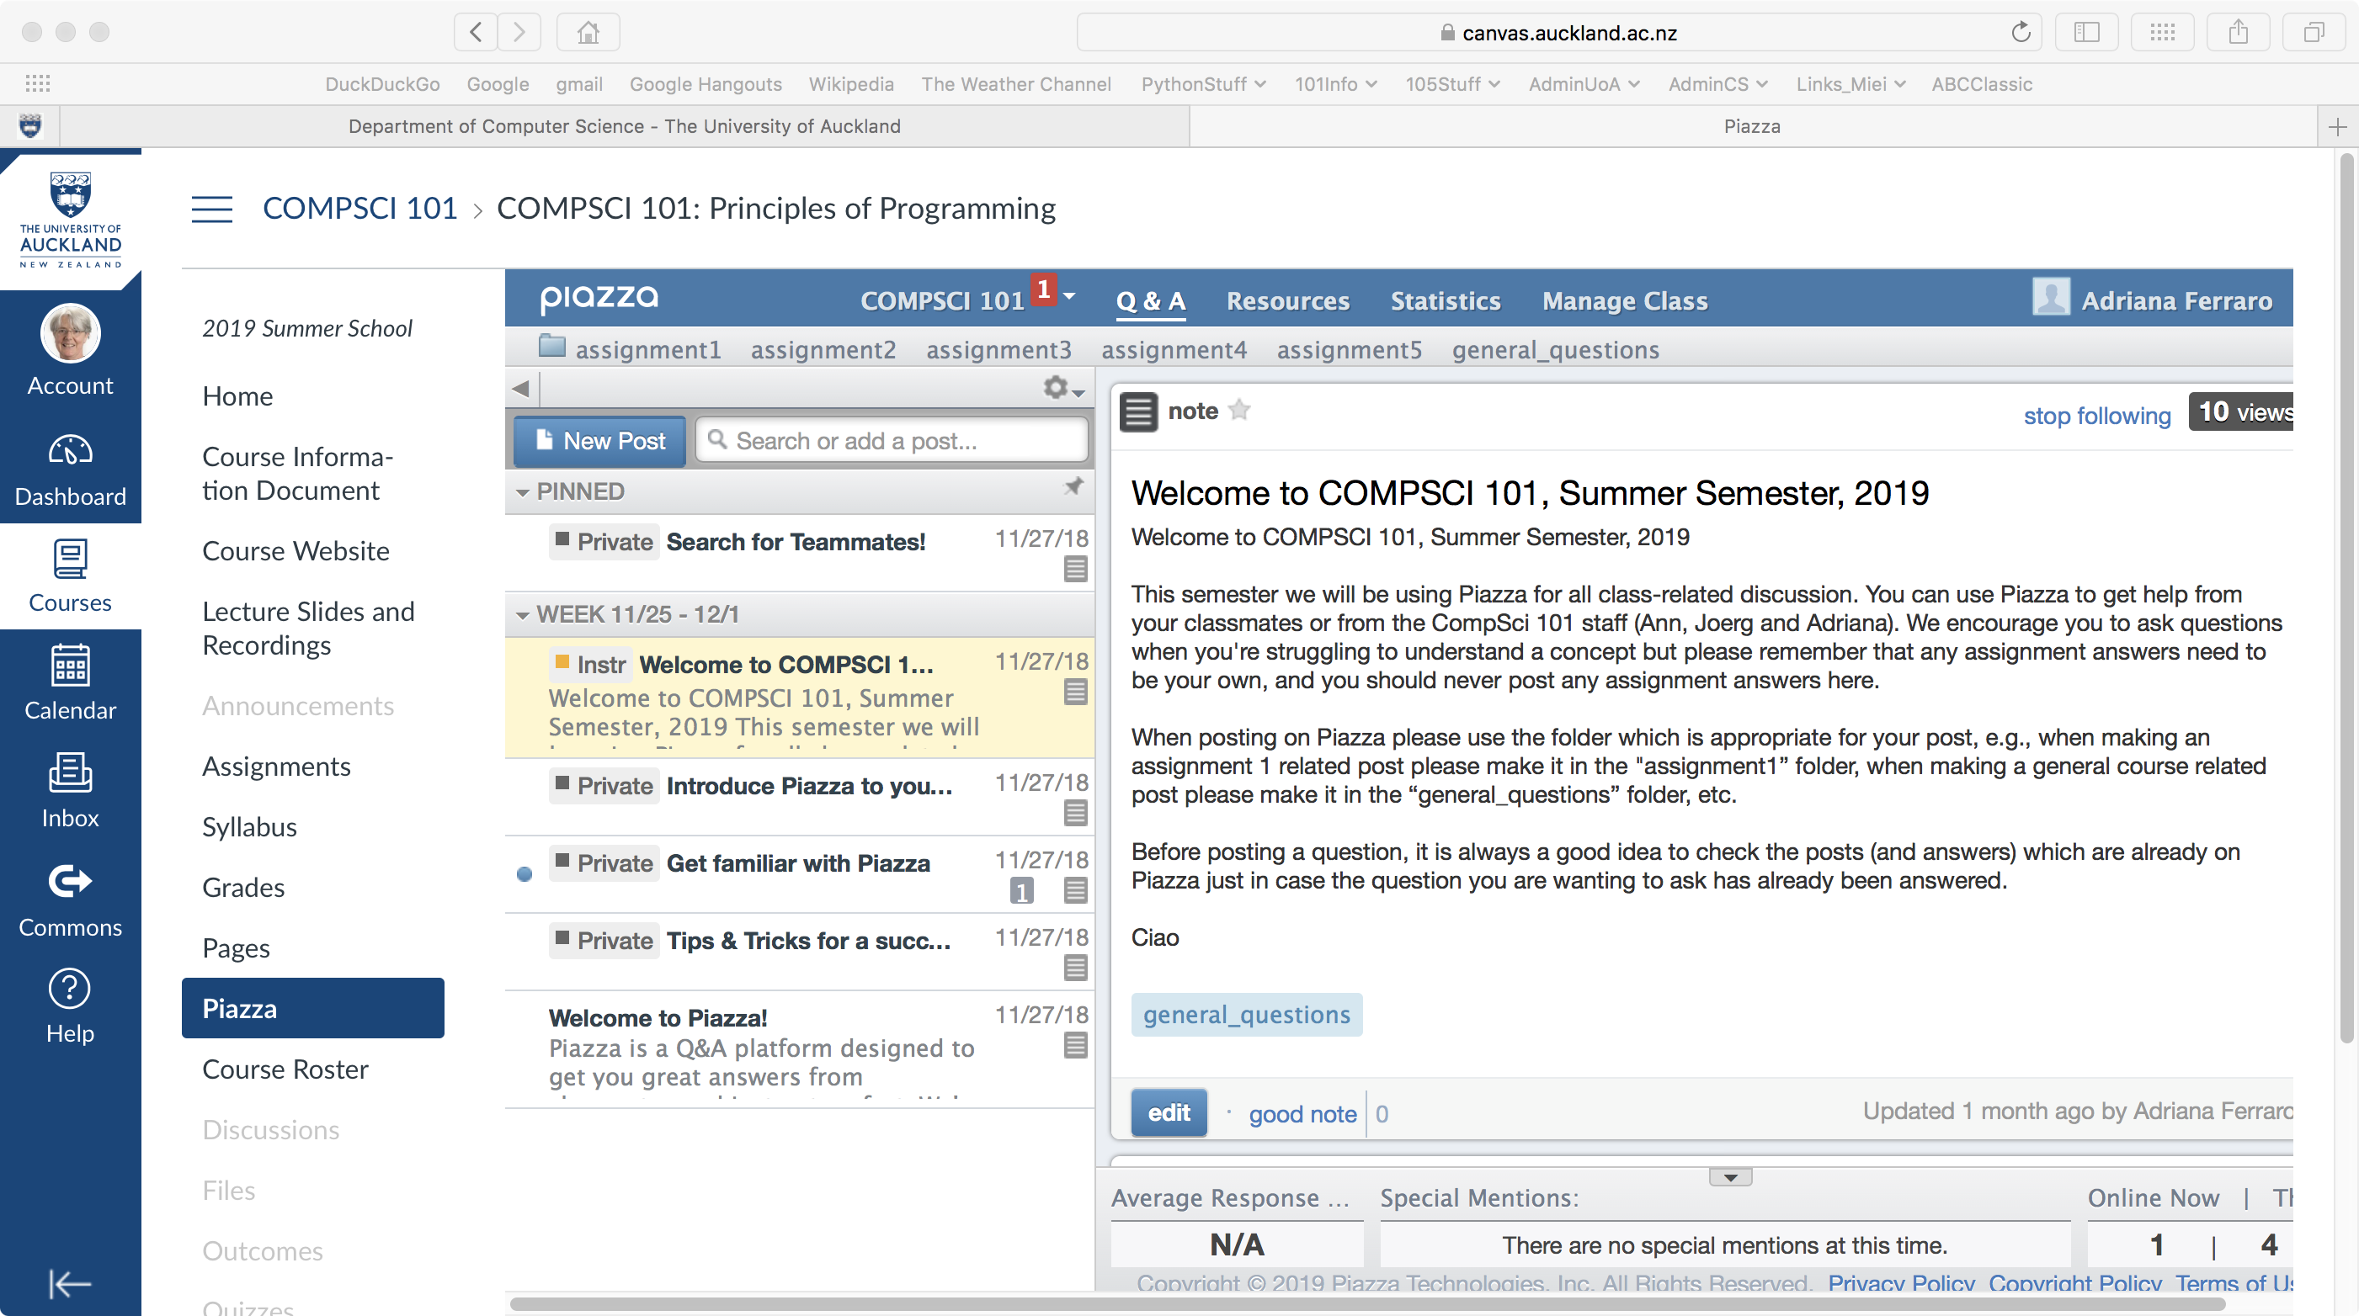
Piazza
We will be using Piazza as our class forum (available in Canvas) for class discussions, assignment, lab, test questions.
Notes:
$12.50

Slide 30
Learning outcomes for CompSci 101
determine the state of the program both during and after execution, given a code listing that may include functions and parameters, loops, conditionals and sequences,
implement a given algorithm using Python,
show that a program meets given specifications by writing appropriate tests,
provide a useful level of documentation, in the form of program comments, for all programs developed,
decompose a simple problem into several smaller tasks,
given a brief textual description of the problem,
compose functions that perform a specified task into a program that solves a given problem,
describe program design and syntax using written language,

Slide 31
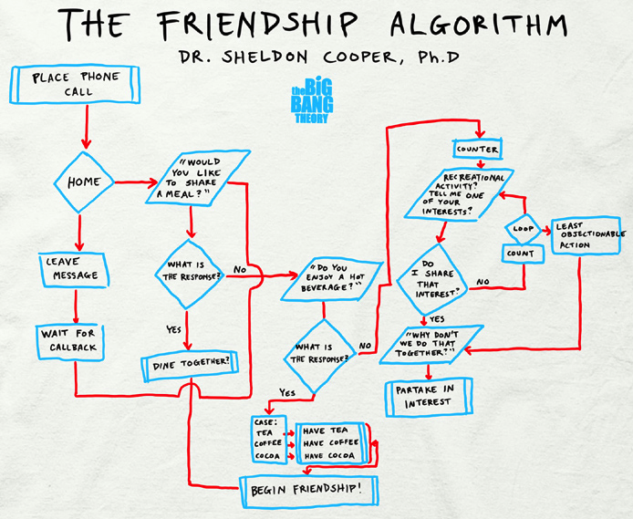
Algorithms
A finite set of steps that specify a sequence of operations to be carried out in order to solve a specific problem.
A better definition:
An algorithm is a
well-defined,
unambiguous
sequence of steps
Notes:
Just a series of actions to perform to get a job done.
step one: look at the last four or three words that were written. step two: search on google for those words as a phrase (i.e. in quotes) step three: find the first webpage in the Google search results for this phrase step four: find out what word followed that phrase on that page step five: write this word down step six: go back to step one, until at least two sentences are written or a maximum of x number of words have been written.

Slide 32
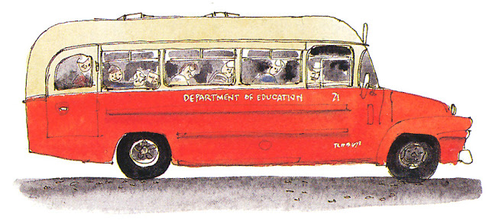
Algorithms – what kind of steps?
HOW TO GET TO UNI
An algorithm is a well-defined, unambiguous sequence of steps
Walk to the bus stop at the shops up the road
sequential
operations
Get on bus number "101"
Pay the bus driver $4.50
Get off at the Symonds St bus stop
Walk 200m to the Computer Science building
Notes:
Just a series of actions to perform to get a job done.
step one: look at the last four or three words that were written. step two: search on google for those words as a phrase (i.e. in quotes) step three: find the first webpage in the Google search results for this phrase step four: find out what word followed that phrase on that page step five: write this word down step six: go back to step one, until at least two sentences are written or a maximum of x number of words have been written.

Slide 33

Algorithms – what kind of steps?
HOW TO WALK TO THE BUS STOP
An algorithm is a well-defined, unambiguous sequence of steps
Open the front door
conditional
operations
[
IF it is raining THEN
take an umbrella
Walk down the driveway and turn left
Walk 50m down the street
Notes:
Just a series of actions to perform to get a job done.
step one: look at the last four or three words that were written. step two: search on google for those words as a phrase (i.e. in quotes) step three: find the first webpage in the Google search results for this phrase step four: find out what word followed that phrase on that page step five: write this word down step six: go back to step one, until at least two sentences are written or a maximum of x number of words have been written.

Slide 34

Algorithms – what kind of steps?
HOW TO PAY THE BUS FARE
An algorithm is a well-defined, unambiguous sequence of steps
iterative
operations
Open wallet
[
WHILE you still haven't paid enough
give the driver another coin
Take a seat
Notes:
Just a series of actions to perform to get a job done.
step one: look at the last four or three words that were written. step two: search on google for those words as a phrase (i.e. in quotes) step three: find the first webpage in the Google search results for this phrase step four: find out what word followed that phrase on that page step five: write this word down step six: go back to step one, until at least two sentences are written or a maximum of x number of words have been written.

Slide 35
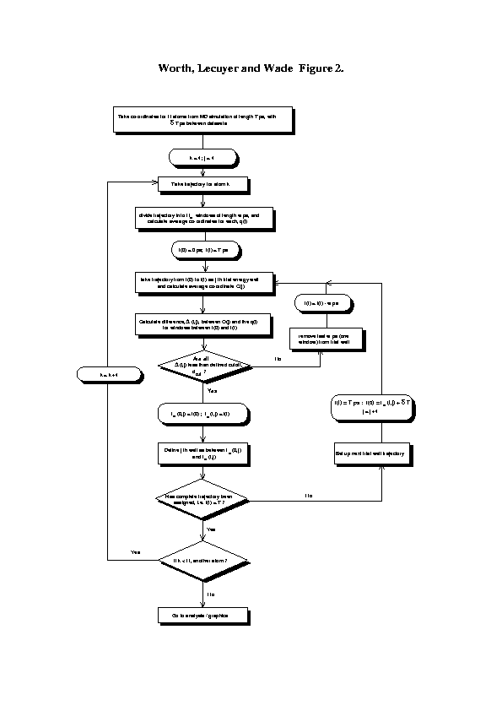
Basic programming steps
TASK
1. design
ALGORITHM
2. coding
CODE
3. testing
PROGRAM
Notes:
Specifying a set of directions which tells a computer exactly how to accomplish some task

Slide 36
Programming - Step 2 - write the code
We will use the Python 3 programming language to implement our algorithms
ALGORITHM
2. coding
Python
CODE
Notes:
Specifying a set of directions which tells a computer exactly how to accomplish some task

Slide 37

Hangman algorithm
Enter a letter: d
+---+
| |
0 |
/|\ |
/ \ |
|
=========
Word: l a _ _ b o n e s
Letters Missed: r m k c u d
Letters Guessed: a e s n o l b
Letters Available: fghijpqtvwxyz
Sorry, you have lost in the game of
Hangman...
The word was lazybones
+---+
| |
|
|
|
|
=========
Word: _ _ _ _ _ _ _ _ _
Letters Missed:
Letters Guessed:
Letters Available: abcdefghijklmnopqrstuvwxyz
Enter a letter: a
Notes:
Specifying a set of directions which tells a computer exactly how to accomplish some task

Slide 38
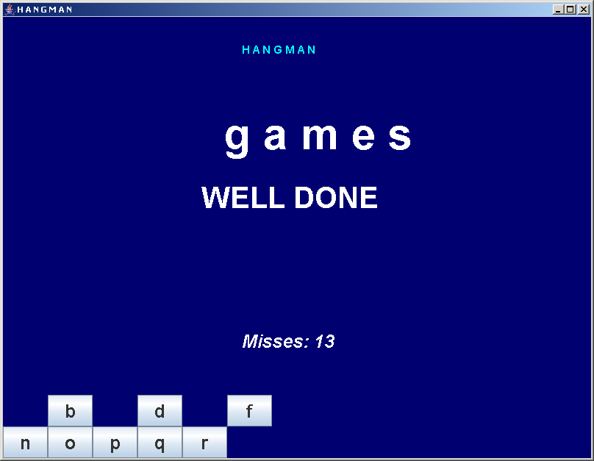
Hangman algorithm
1
2
3
4
5
6
7
8
9
display a "_" for each character in the word
display "Goodbye!"
generate a secret word
GO BACK to waiting for the user to guess a letter
wait for the user to guess a letter
IF the whole word is guessed THEN
display "Congratulations …" and print a salutation
set "misses" to 0
IF the number of misses is 6 THEN
display "Sorry …" and print a salutation
IF the letter is in the word
replace the corresponding "_" with the letter
otherwise
add 1 to the number of "misses"
Notes:
Specifying a set of directions which tells a computer exactly how to accomplish some task

Slide 39
Hangman algorithm
(3) generate a secret word
(1) display a "_" for each character in the word
(7) set "misses" to 0
(5) wait for the user to guess a letter
(9) IF the letter is in the word
replace the corresponding "_" with the letter
otherwise
add 1 to the number of "misses"
(6) IF the whole word is guessed THEN
display "Congratulations …" and go to (2)
(8) IF the number of misses is 6 THEN
display "Sorry …" and go to (2)
(4) GO BACK to (5)
(2) display "Goodbye!"

Slide 40
Hangman algorithm
(3) generate a secret word
(1) display a "_" for each character in the word
(7) set "misses" to 0
(5) wait for the user to guess a letter
(9) IF the letter is in the word
replace the corresponding "_" with the letter
otherwise
add 1 to the number of "misses"
(6) IF the whole word is guessed THEN
display "Congratulations …" and go to (2)
(8) IF the number of misses is 6 THEN
display "Sorry …" and go to (2)
(4) GO BACK to (5)
(2) display "Goodbye!"
sequential operations
conditional operations
iterative operations

